Slide 1



“ Create a platform for sharing coding resources and tutorials.”
PROJECT MEMBERS : DHARUN PRAKASH G.T [23ITR034]
PROJECT GUIDE : Dr.T.AbiRami ,
Department of Information Technology

Slide 2
Problem Description
Managing monthly expenses like rent, electricity, water, and internet bills can be overwhelming. People often struggle to keep track of due dates, pending payments, and overall spending. This can lead to missed payments, late fees, and financial mismanagement.
Our Rent and Utility Expense Tracker provides a simple and efficient way to log, view, and manage expenses. It helps users track due dates, categorize expenses, and stay financially organized—all in one place!

Slide 3
Objectives
✔ Simplify Expense Tracking – Easily log rent and utility expenses in one place. ✔ Stay Organized – View all expenses with due dates and payment status. ✔ Avoid Late Fees – Get a clear overview to manage payments on time. ✔ Easy Management – Add, view, and remove expenses effortlessly. ✔ User-Friendly Interface – Simple and intuitive design for smooth navigation.

Slide 4
Software / Hardware Tools used
Software Tools:
Frontend: HTML, CSS, JavaScript
Backend (if needed): Node.js, MySQL
Database (if needed): MySQL
IDE / Code Editor: VS Code,
Version Control: Git, GitHub

Slide 5
Implementation Details
✅ Frontend: HTML, Tailwind CSS, JavaScript for a clean UI. ✅ Backend (if needed): Local Storage / Firebase / MySQL for data handling. ✅ Core Features: Add, view, and remove expenses with smooth navigation. ✅ Data Storage: Local storage for now; can integrate Firebase/MySQL later. ✅ Deployment: Host on GitHub Pages, Netlify, or Firebase. 🚀

Slide 6
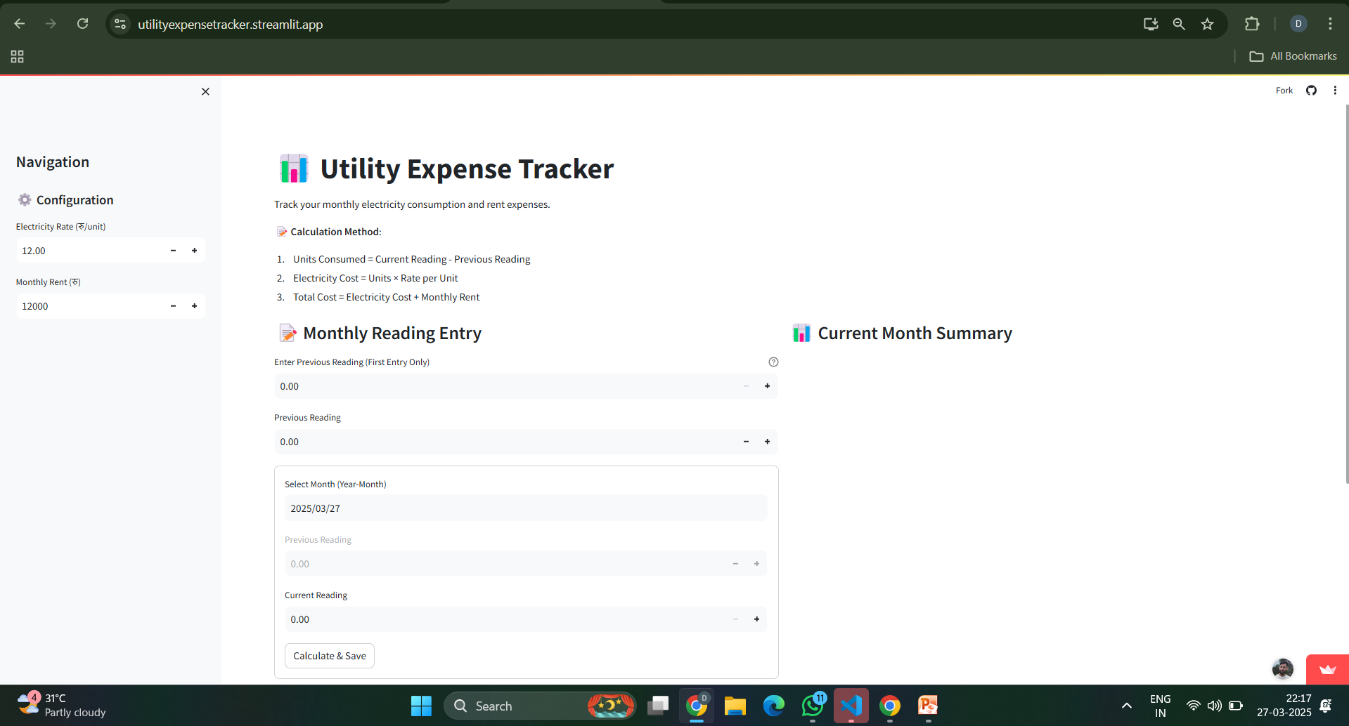
Websites similar to my project idea
Streamlit

Slide 7
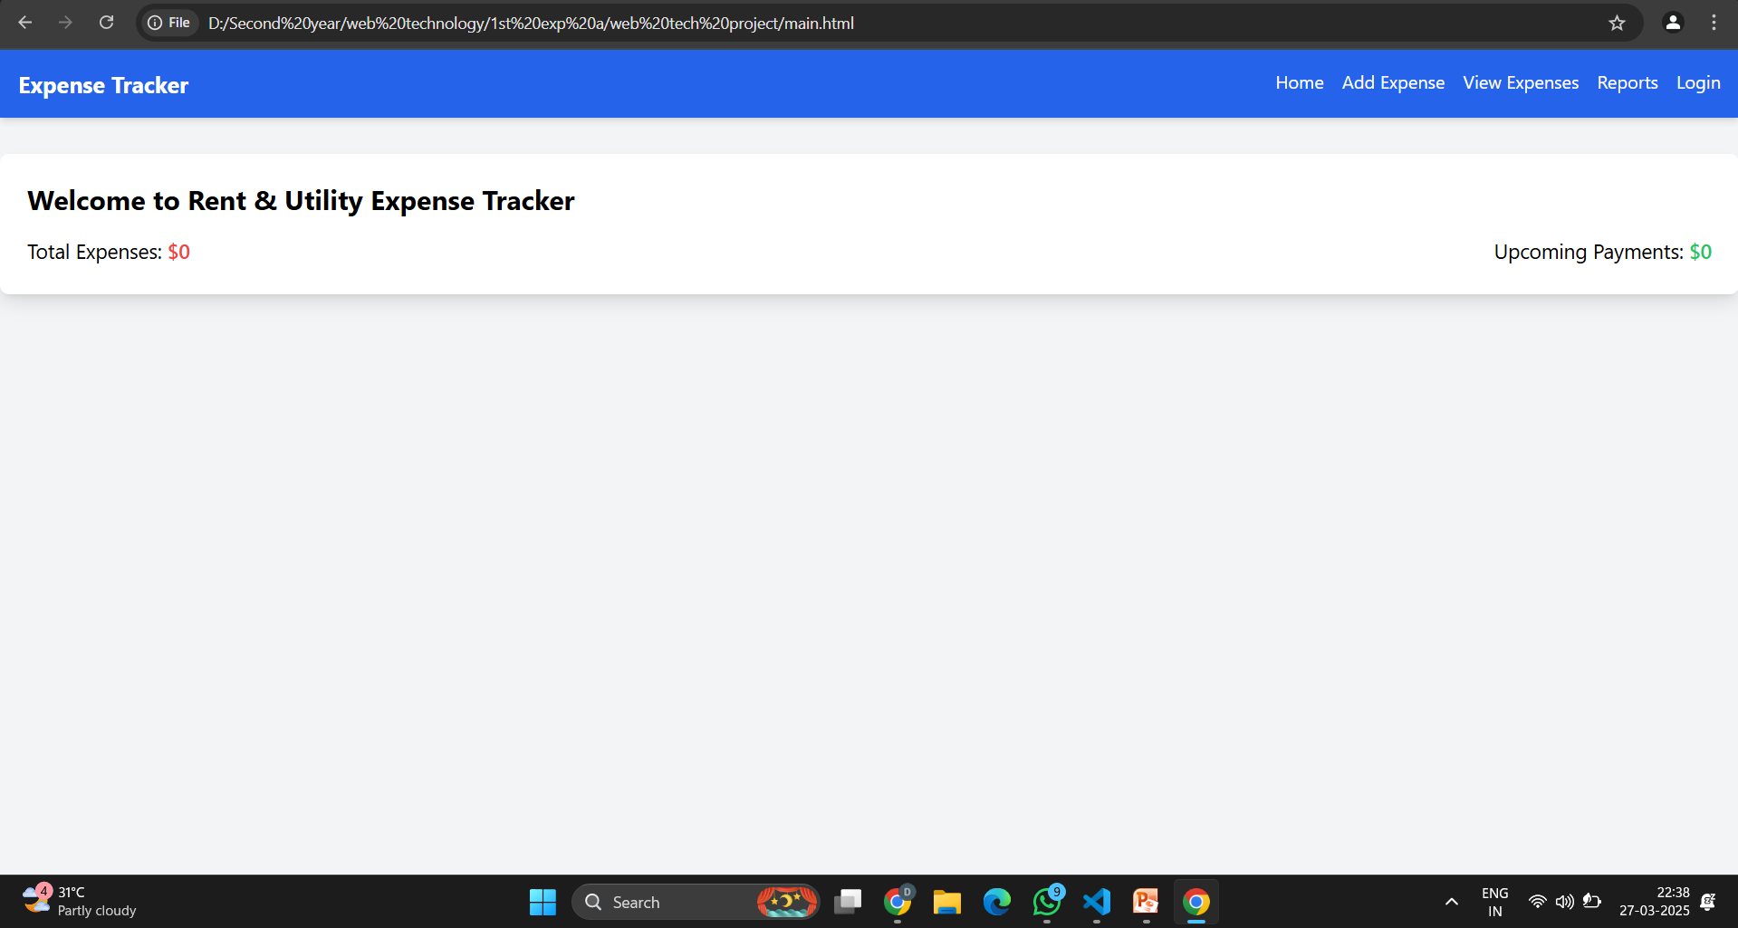
OUTPUTS

Slide 8
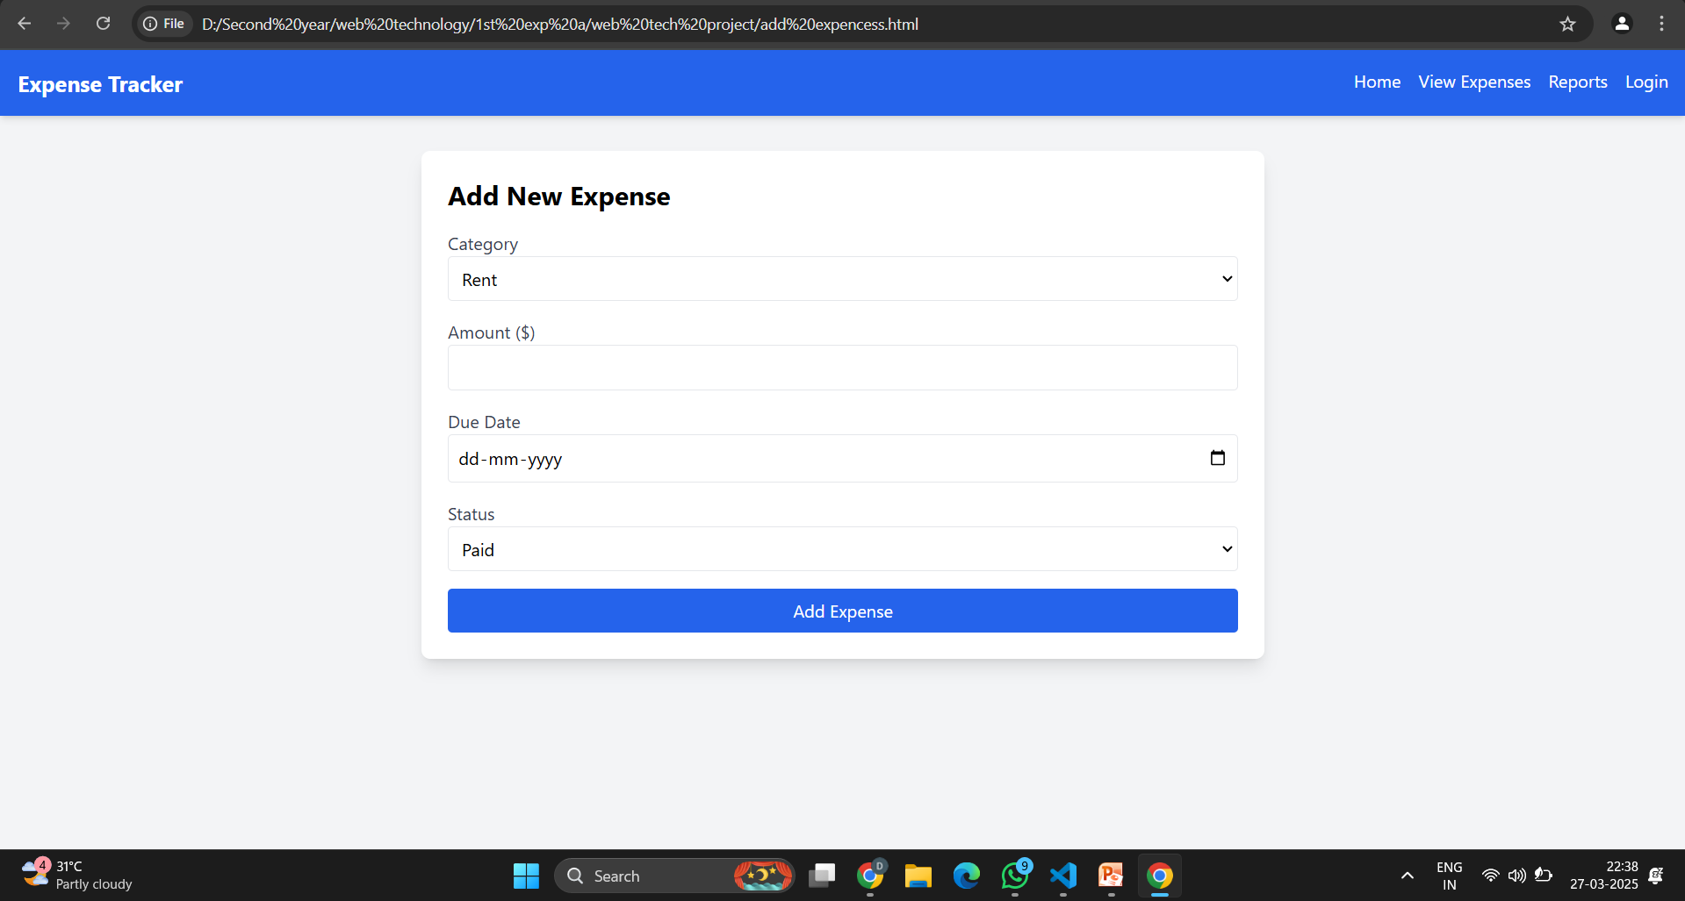

Slide 9
WORKFLOW
User Logs In
Hosting
Add Expense
Server using Node
Store Data
Retrieve Data

Slide 10
GIT Hub Link
https://github.com/dharunprakashgt/webtech-projects.git

Slide 11
Thank you!

